Slide 1
Properties
Srikar Mylavarapu

Slide 2
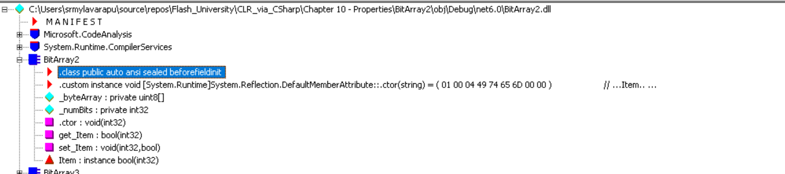
Questions from last week
None of note
-- init properties
-- what level do anonymous types get disambiguated at

Slide 3
Parameterless Properties
Problem 1
Not encapsulating
Allow unconstrained behavior
Problem 2
Becomes kind of unwieldy
‘boilerplate’
How do other languages do the exact same thing
- If we look at getters and setter in Java, it’s the ‘same thing’

Slide 4
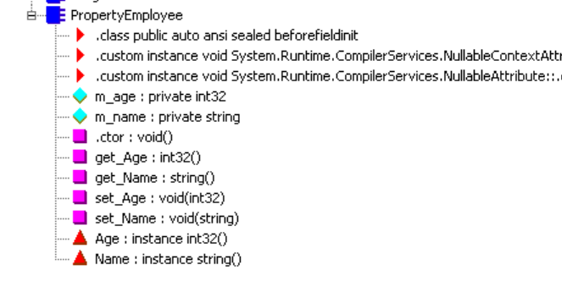
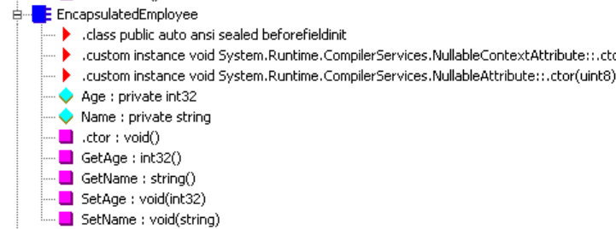
A property will get: getter and/or setter (see purple) and red triangle property definition

Slide 5
Lombok
Lombok is a type of chili
Basically, in Java, we’d have a lot of boiler plate for the same thing
Good and bad part about this?
Think about order

Slide 6
Properties of properties
Can’t overload
‘smart fields’ with additional logic behind them
AIP (autoimplemented)
Means that you can’t debug them
‘methods that look like fields’
Jeffrey says ‘why’
Just write them out

Slide 7
Actual reasons
Properties are readonly or write only,
Property method may have an exception, field access won’t
Properties can’t be passed as an out or ref
Properties can take time
Field access is immediate
Properties called multiple times might return a different value; fields are consistent

Slide 8
Object and Collection Initializers
How can we instantiate objects?
What is the best practice
The joys of one liners
Look at constructor in tests from PR.

Slide 9
Anonymous Types
What is a (tu,ple)?
var o1 = new {Name = "Orwell", Year = 1984};
Really similar to what other languages?
What does this look like in IL?
Does this get resolved to a Type or is this the exception where we do some non type safe magic?

Slide 10
The compiler is sentient
We have a ‘named parameter’ (named local variable) so the compiler knows the name should be Orwell’
The compiler can ‘infer’ types
Be careful with this (See JavaScript → WAT Arguably my favorite tech talk of all time. I’m not saying C# is javascript, but reading it made me think of it.
Not sure how to actually understand this more than just looking at the IL.
How do we prove the types are the same?

Slide 11
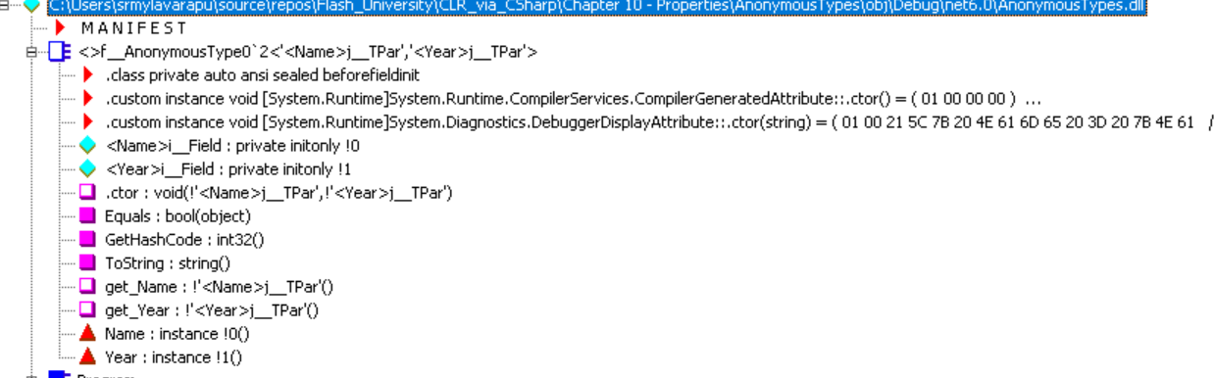

Slide 12
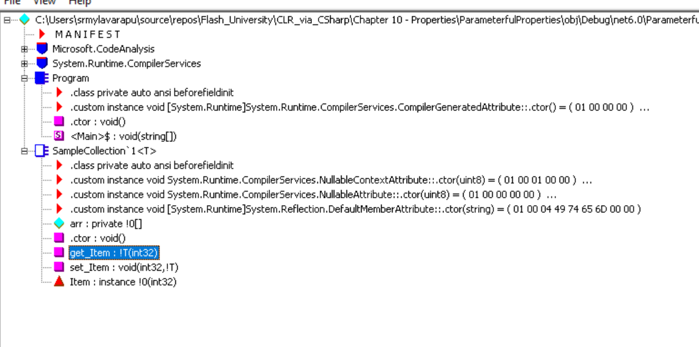
Parameterful Properties (indexers)
First reaction was ‘Jeffrey said parameters don’t take properties… what sorcery is this
Honestly, I don’t feel like I understand this enough but here goes

Slide 13
Bit Array 2
Time to have ‘fun’

